Slide 1
Punking the digital archive: history, pedagogy and practice
Lucy Robinson, Chris Warne (History, University of Sussex)
Kitty Horne (TEL, University of Sussex)

Slide 2
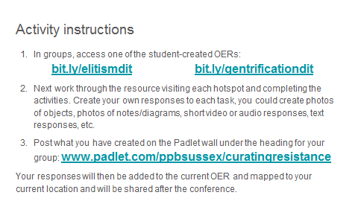

Slide 3
Introducing DiT/diy digital
‘Post-Punk Britain: 1975 – present’ – making popular culture the point
Students build a personal archive through the module
Build and share Open-access Educational Resources (OERs)

Slide 4
Post-Punk Britain – doing punk as a process not subject
Punkademics, The Subcultures Network, Punk Scholars Network, KISMIF
Collaborative, scavenger, DIY history
Relationship between digital and textual history

Slide 5
DIY/DIT Digital: what we do
Students collaboratively produce OERs
Think about the relationship between what we do in the academy and the world beyond
Think about how we do our teaching
Interrogate what’s taken for granted in the contemporary university
Confront and acknowledge what if feels like to not actually know where you are going
Digital pedagogy – not ‘cheaper, bigger, faster’

Slide 6
A History of DIT/DIY Digital
Year One
“Think about the module section you need to understand and then analyse a concept”
Padlet: The Cultural Circuit and Moral Panics

Slide 7
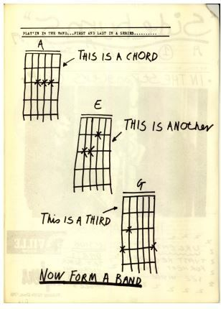
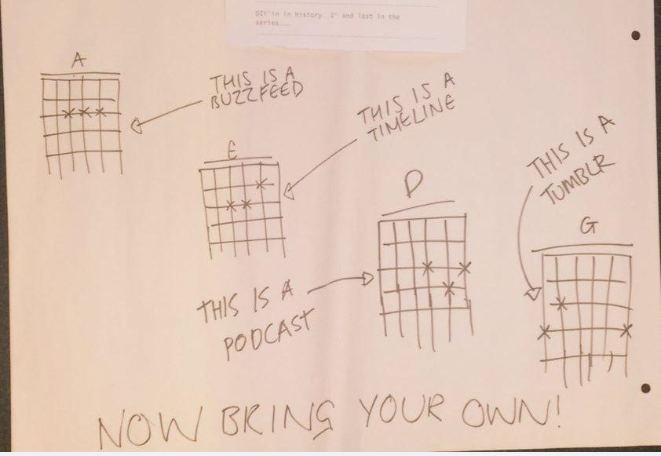
Post-Punk Britain students, May 2015
Sideburns, no. 1, Jan 1977

Slide 8
A History of DIT/DIY Digital
Year Two
Real world settings
Dreamland Margate -- Turner Gallery -- Iain Aitch’s Oral History Project

Slide 9
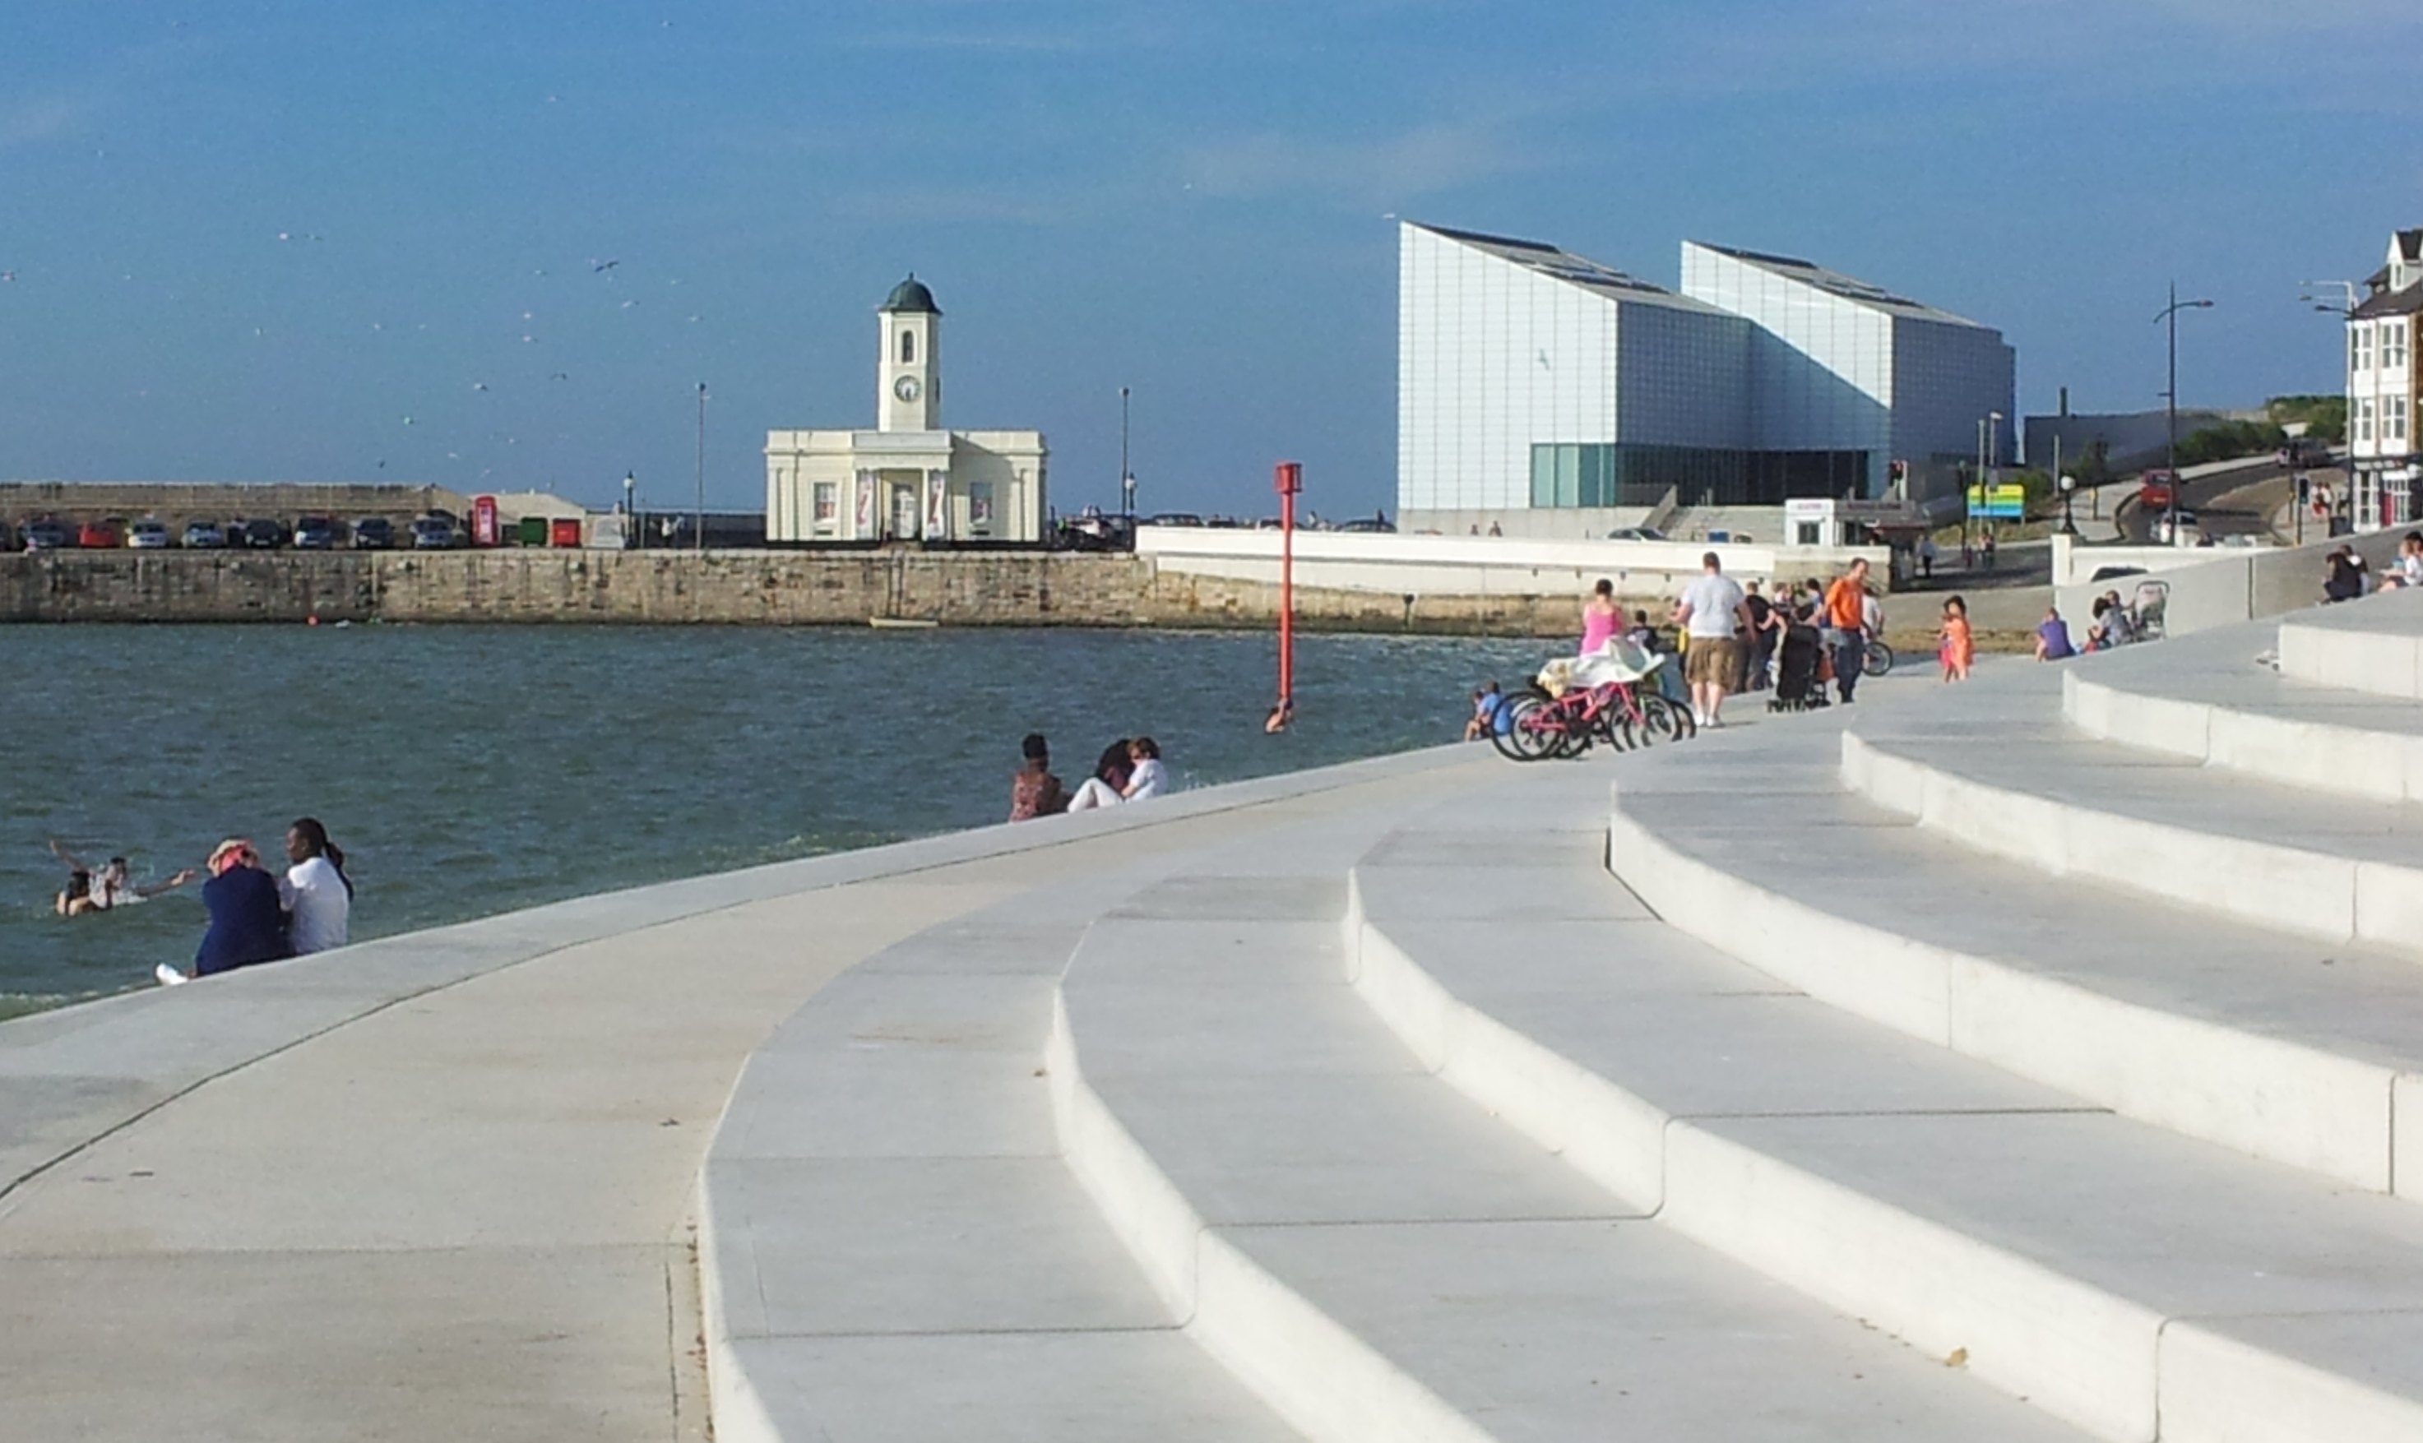
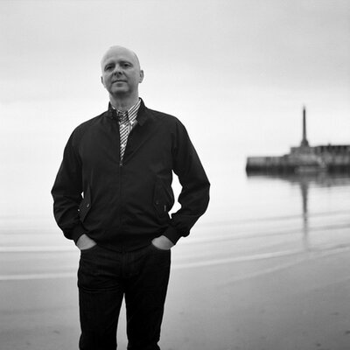

Slide 10
A History of DIT/DIY Digital
Year Two
Real world settings
Dreamland Margate -- Turner Gallery -- Iain Aitch’s Oral History Project
Briefs from Rebecca Ellis, Director of Events and Programming
Digital Technology in an Analogue Park
The New Vintage
How does a 'cool' profile fit with local families and their needs? How can culture rejuvenate a community?
Thinglink: Vintage and Heritage

Slide 11
A History of DIT/DIY Digital
Year Three
Real world settings
Vivienne Westwood’s Intellectuals Unite

Slide 12
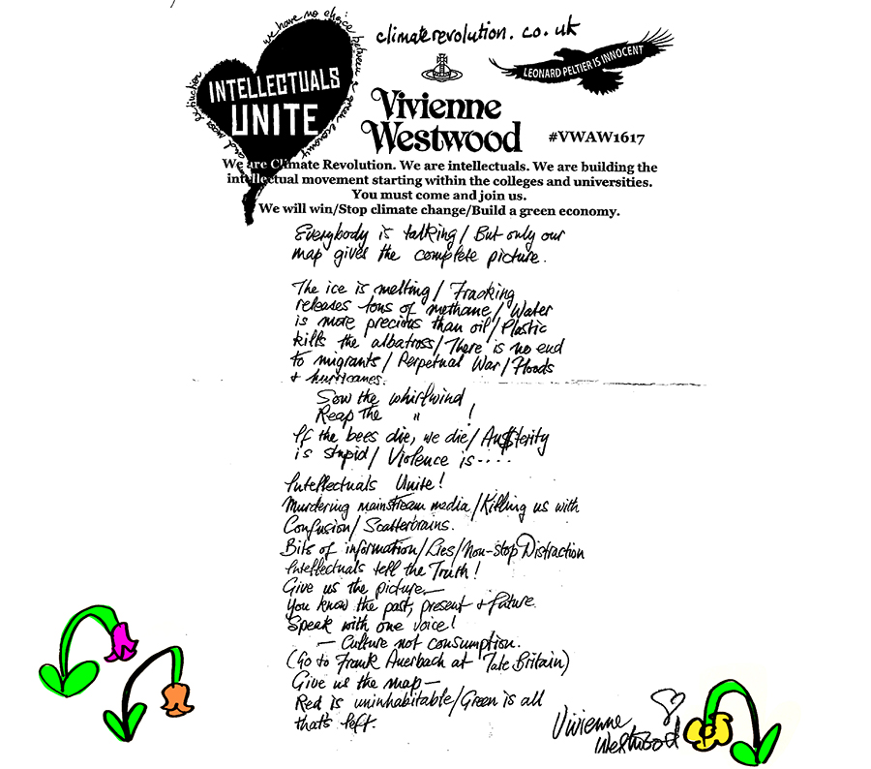
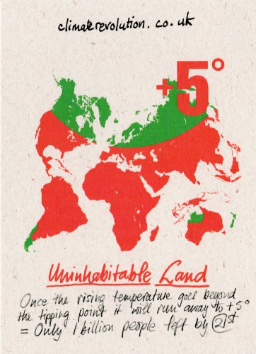

Slide 13
A History of DIT/DIY Digital
Year Three
Real world settings
Vivienne Westwood’s Intellectuals Unite
Punk’s 40th Anniversary
Geolocation – tying content to local histories
‘Active Resistance to Propaganda’
Paneek: Elitism in Subcultures

Slide 14
Activity instructions
In groups access the Padlet wall by following this link: www.padlet.com/ppbsussex/curatingresistance
Then follow the guidance on the Padlet wall under the ‘Instructions’ column.
Your responses will then be added to the current OER, mapped to your current location and will be shared after the conference.

Slide 15
By way of conclusion: The Lessons we have learned from DIT/DIY Digital
Confronting the gatekeepers
Radical expectations, mundane realities
Working democratically is tricky
Making do with what you’ve got
Toxicity
Share our DIT Toolkit

